Slide 1
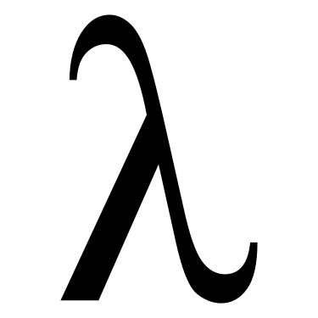
MSFT PL Meetup

Slide 2

Practical Foundations for Programming Languages
Chapter 3

Slide 3


If you are interested in working on the exercises, please make a pull request to this GitHub repo’s solutions folder. https://github.com/Mossaka/MSFT_PL_Meetup
Join our discord server: https://discord.gg/uz9YUvV

Slide 4
Practical Foundations for Programming Languages
Chapter 3

Slide 5
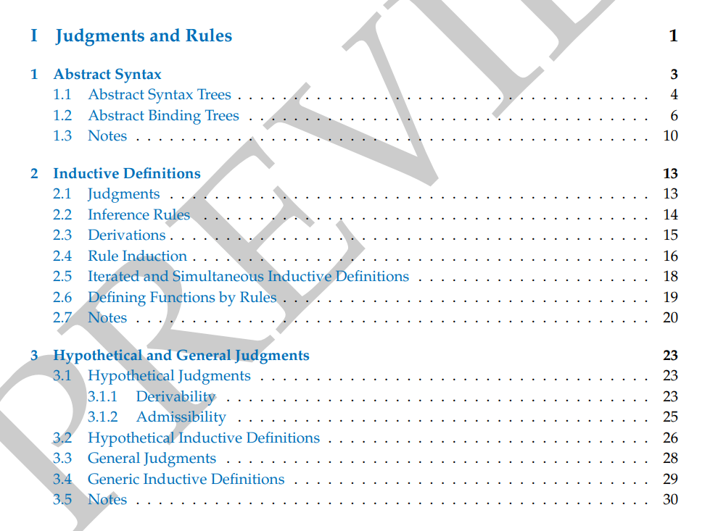

Slide 6
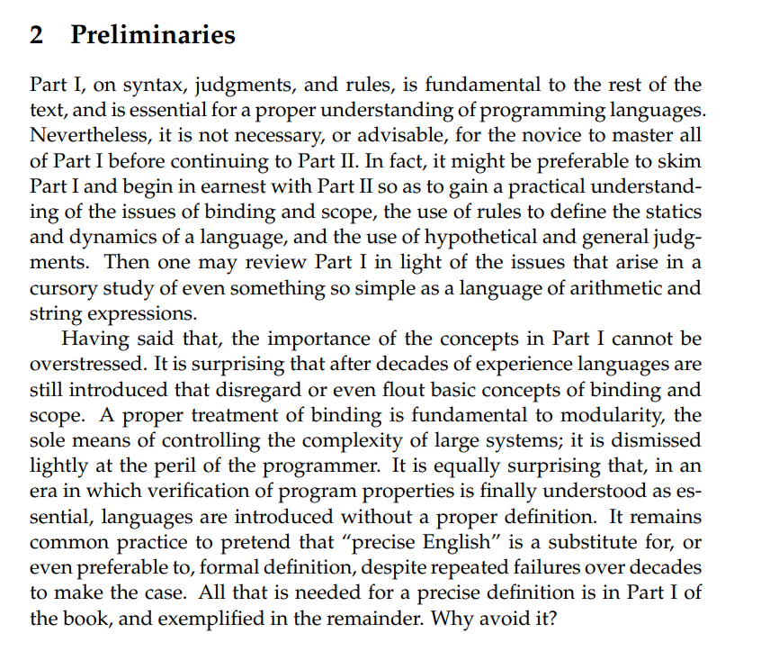

Slide 7
The hypothetical judgment codifies the rules for expressing the validity of a conclusion conditional on the validity of one or more hypothesis

Slide 8
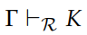
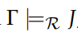
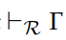
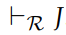
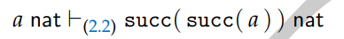
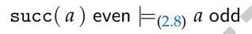
Derivability vs Admissibility
 | derivability | admissibility
Def | We may derive K from R U Γ of the rules R w/ axioms Γ | implies
e.x.
properties | Stability, Reflexivity, Weakening, Transitivity | Reflexivity, Weakening, Transitivity
relationship | Stronger refers to Theorem 3.2 | Weaker

Slide 9
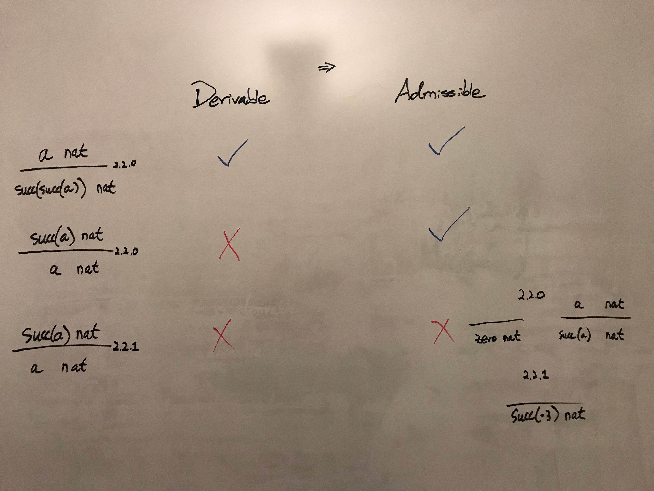
Examples and Counter-examples

Slide 10
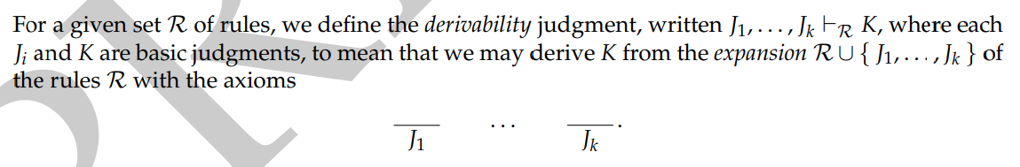
Derivability

Slide 11
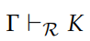
Γ or Δ
We use Greek letters to stand for a finite set of basic judgements, and write R U Γ for the expansion of R with an axiom corresponding to each judgement in Γ.
This means that K is derivable from rules R U Γ.

Slide 12
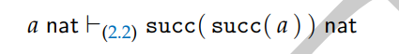
Am example

Slide 13
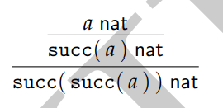

Slide 14
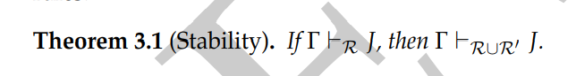
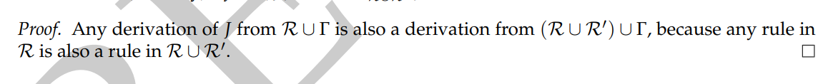
Theorem 3.1 Stablity

Slide 15
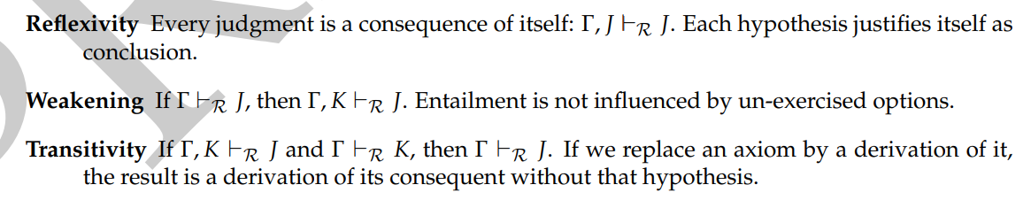

Slide 16
Proof
Reflexivity:
J infers J
Axioms in Γ infer J

Slide 17
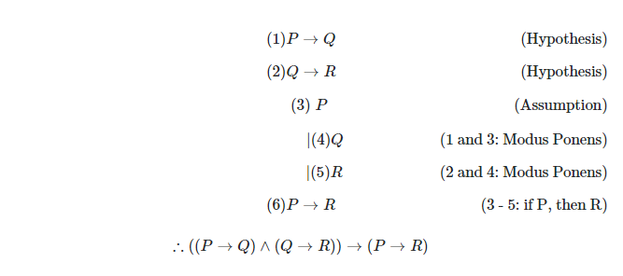
https://math.stackexchange.com/questions/280893/how-do-i-prove-the-transitivity-of-a-set-of-implications

Slide 18
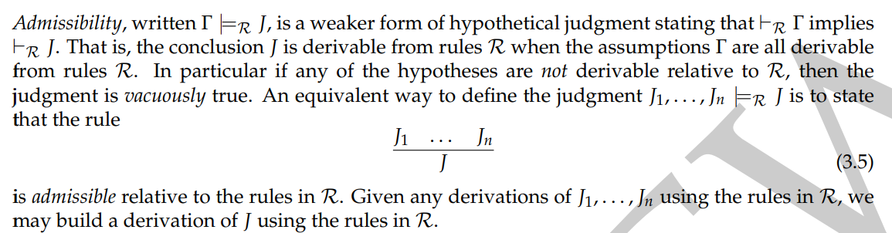
Admissibility

Slide 19
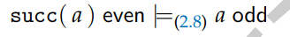
An example

Slide 20
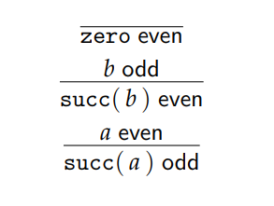
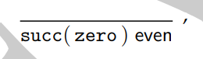
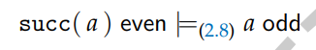
An counter-example
Is inadmissible

Slide 21
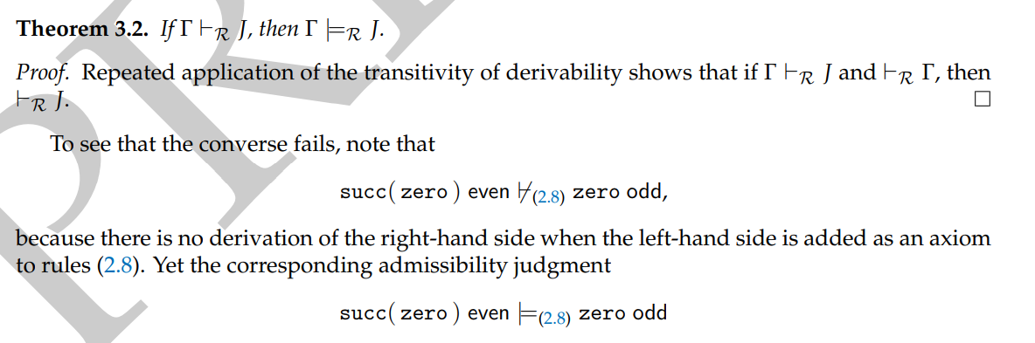
Theorem 3.2 Derivability is stronger than Admissibility

Slide 22
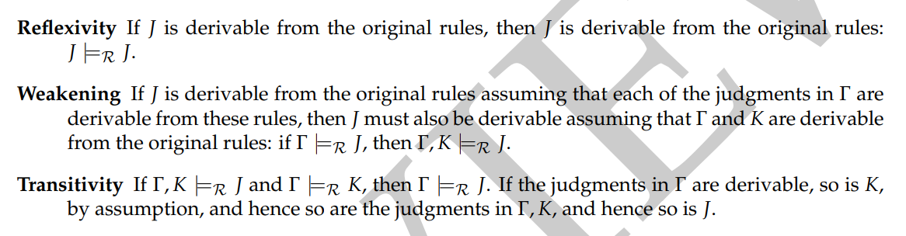

Slide 23
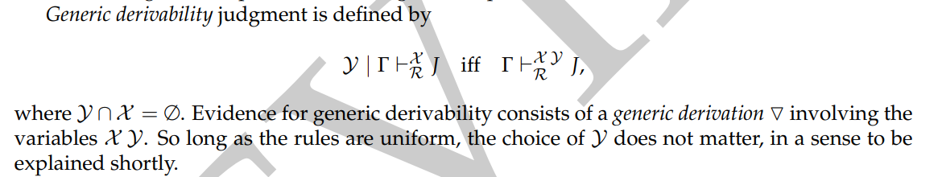
3.3 General Judgements

Slide 24
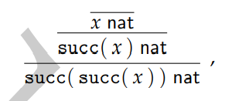
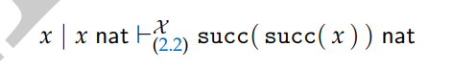
An example
Left is an evidence of right, providing that x not in X

Slide 25
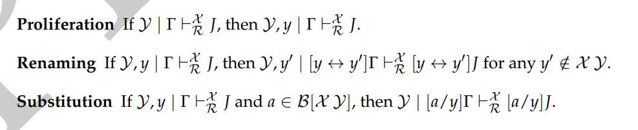
Structural Properties

Slide 26
Proof ?

Slide 27
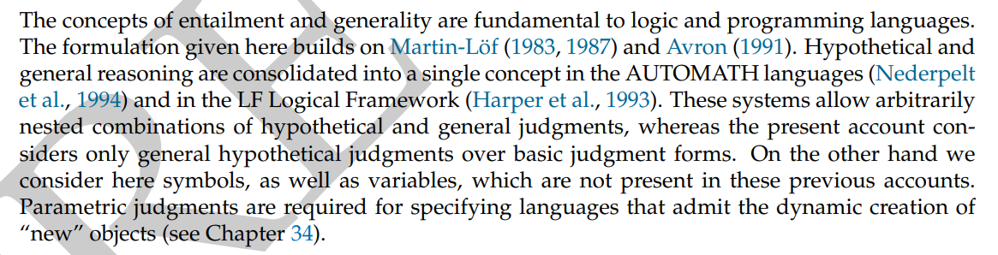
3.5 Notes
https://en.wikipedia.org/wiki/Per_Martin-L%C3%B6f

